Slide 1


Transforming ERD into Relations
Asif Sohail
University of the Punjab
Punjab University College of Information Technology (PUCIT)

Slide 2
Logical Database Design
Conceptual Data Model
Transform
Logical Data Model

Slide 3
Data Models
Model of
system
in client’s
mind
Entity model of
client’s model
Table model
of entity model
Server
Tables on disk
Notes:
Data Models
Models are a cornerstone of design. Engineers build a model of a car to work out any details before putting it into production. In the same manner, system designers develop models to explore ideas and improve the understanding of the database design.
Purpose of Models
Models help communicate the concepts in people’s minds. They can be used to do the following:
Communicate
Categorize
Describe
Specify
Investigate
Evolve
Analyze
Imitate
The objective is to produce a model that fits a multitude of these uses, can be understood by an end user, and contains sufficient detail for a developer to build a database system.

Slide 4
Transforming ERD into Relations
The transformation consists of two steps:
  Transform Entities
  Transform Relationships
Each entity of an ER Diagram is represented as a relation.
The relational representation of relationship of an ER diagram depends both on the degree and cardinality of the relationship.

Slide 5
1. Transforming Entities
There are three types of entities:
  Regular entities
  Weak Entities
  Associative Entities

Slide 6
1. Transforming Entities
a) Regular entities
Transform each regular entity type into a Relation
Convert simple attribute of the entity type into an attribute of the relation
Make identifier the Primary Key
Composite Attribute: Include only simple components of the composite attribute in the relation
Multivalued Attribute:
  Create two relations
  The first relation contains all of the attributes of the entity type except the multivalued attribute
  The second relation contains two attributes that form the PK of the second relation i.e.
    The PK of the first relation as FK to this relation
    The multivalued attribute

Slide 7
Mapping Regular Entity CUSTOMER
Customer_Name
CUSTOMER Entity Type
Customer_ID
CUSTOMER
Customer_Address
CUSTOMER Relation
CUSTOMER
Customer_ID
Customer_Name
Address

Slide 8
Composite Attribute
City
Street
State
Customer_Name
CUSTOMER Entity Type with Composite Attribute
Zip
Customer_ID
CUSTOMER
Customer_Address
CUSTOMER Relation
CUSTOMER
Customer_ID
Customer_Name
Street
City
State
Zip

Slide 9
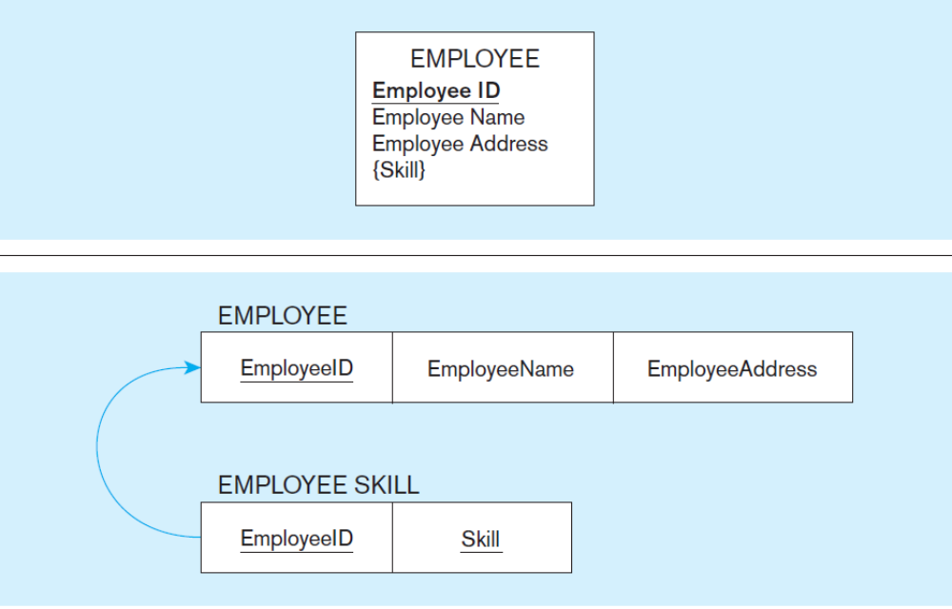
Multivalued Attribute

Slide 10
1. Transforming Entities
b) Weak entities
Create a new relation
Include all simple attributes as attributes of this relation
Include PK of identifying relation as FK to the new relation
The PK of new relation is (PK of identifying relation + Partial identifier of weak entity)

Slide 11
Continued…
Last_Name
First_Name
Weak Entity
Employee_Name
Dependent_Name
Date_of_Birth
Employee_ID
EMPLOYEE
Has
DEPENDENT
Gender
Resulting relations from weak entity
EMPLOYEE
Employee_ID
Employee_Name
DEPENDENT
First_Name
Last_Name
Employee_ID
Date_of_Birth
Gender

Slide 12
1. Transforming Entities
c) Associative Entities
Create a new relation
Include PK of the participating entities along with the attributes of the associative entity in the new relation

Slide 13
Map Associative Entities
Product_ID
Order_Date
Standard_Price
Order_ID
Quantity
ORDER
NURSE
ORDER_LINE
PRODUCT
Resulting Relations
Product_Desc
Product_Finish
ORDER
Order_ID
Order_Date
PRODUCT
Product_ID
Product_Desc
Product_Finish
Standard_Price
ORDER_LINE
Product_ID
Order_ID
Quantity

Slide 14
Map Associative Entities
Vendor_ID
Name
Address
Shipment_No
Customer_ID
Date
CUSTOMER
NURSE
SHIPMENT
VENDOR
Amount
Resulting Relations
CUSTOMER
Customer_ID
Name
SHIPMENT
Shipment_No
Customer_ID
Vendor_ID
Others
VENDOR
Vendor_ID
Address
Other attributes

Slide 15
2. Transforming Relationships
There can be following types of a relationship:
  Binary Relationship
  Unary Relationship
  Ternary Relationship
  Super type / Subtype Relationship

Slide 16
2. Transforming Relationships
Binary Relationship
  i) One to Many
It is represented by the PK of the entity having one cardinality as a FK in the relation representing the entity having many cardinality
Example: Department - Employee (1:M)
  ii) One to One
It is represented by the PK of the entity having mandatory cardinality as a FK in the relation representing the entity having optional cardinality
Example: Student – Project (1:1)

Slide 17
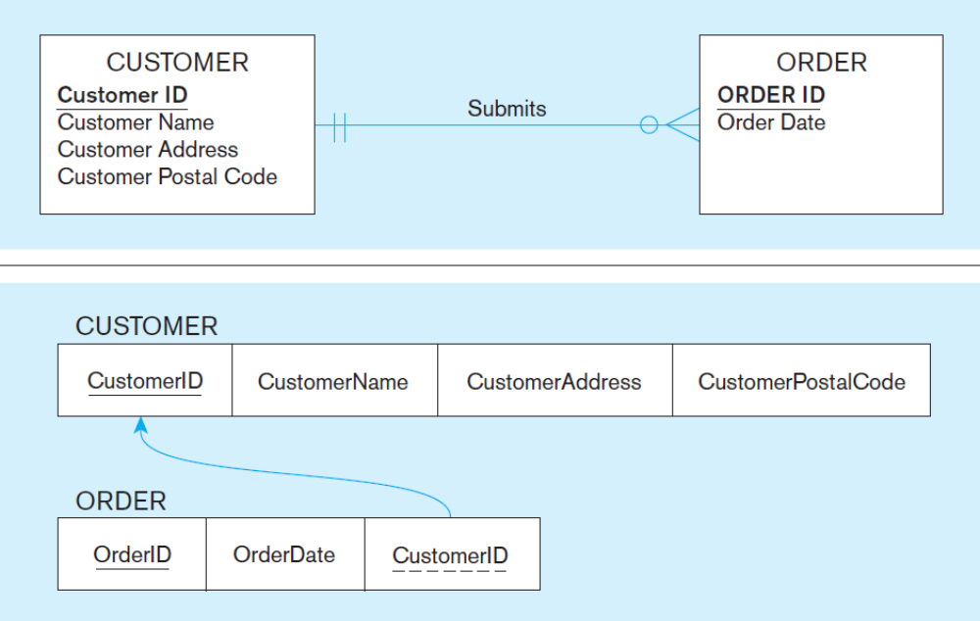
Binary Relationship (1:M)

Slide 18
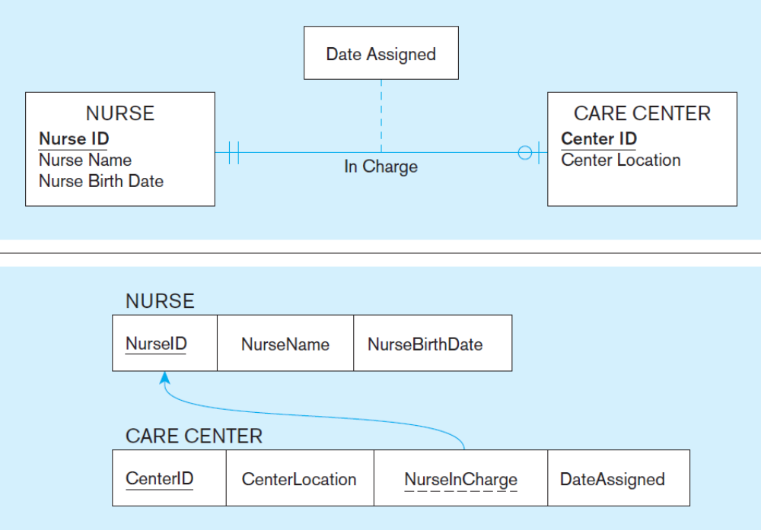
Binary Relationship (1:1)

Slide 19
2. Transforming Relationships
Binary Relationship
  iii) Many to Many
A new relation is created consisting of Primary Keys of both the entities plus the attributes of the relationship.
Example: Order – Product (M:N)
Student – Course (M:N)

Slide 20
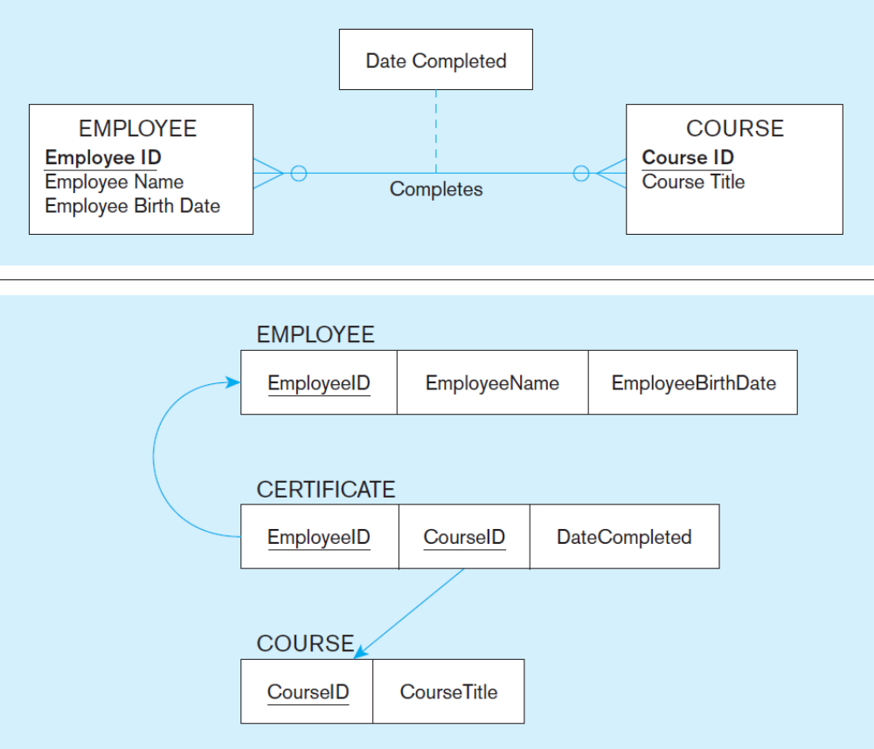
Binary Relationship (M:N)

Slide 21
Map Binary Relationships
M:N Relationship
Vendor_ID
Standard_Cost
Vendor_Name
Unit_of_Measure
Unit_Price
Material_ID
RAW MATERIAL
Supplies
VENDOR
Three Resulting Relations
Vendor_Address
RAW MATERIALS
Material_ID
Standard_Cost
Unit_of_Measure
QUOTE
VENDOR
Material_ID
Vendor_ID
Unit_Price
Vendor_ID
Vendor_Name
Vendor_Address

Slide 22
2. Transforming Relationships
b) Unary Relationship
  One to One
  One to Many
A FK is introduce in the relation obtained from the entity and this FK refers the PK of the same relation. Such FK is called Recursive FK.

Slide 23
2. Transforming Relationships
Unary 1:N Relationships
Employee_ID
Name
Birthdate
EMPLOYEE
Manages
Employee Relation with Recursive Foreign Key
An FK in a relation that references the PK values of that relation
EMPLOYEE
Employee_ID
Name
Birthdate
Manager_ID

Slide 24
2. Transforming Relationships
b) Unary Relationship
  iii) Many to Many
A new relation is created consisting of Primary Key of the entity repeated twice with different names plus the attributes of the relationship.

Slide 25
Map Unary Relationships
Unary M:N Relationships
Quantity
Item_No
Name
Unit_Cost
ITEM
Contains
ITEM & COMPONENT relations
ITEM
Item_No
Name
Unit_Cost
COMPONENT
Item_No
Component_No
Quantity

Slide 26
2. Transforming Relationships
c) Ternary Relationship
A new relation is created consisting of Primary Keys of all the three entities participating in the relationship plus the attributes of the relationship.

Slide 27
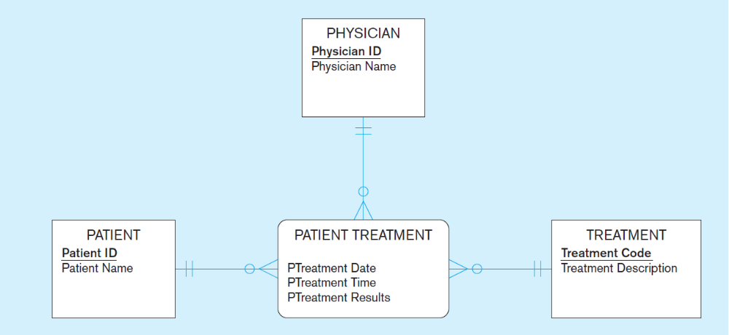
Transforming Ternary Relationship

Slide 28
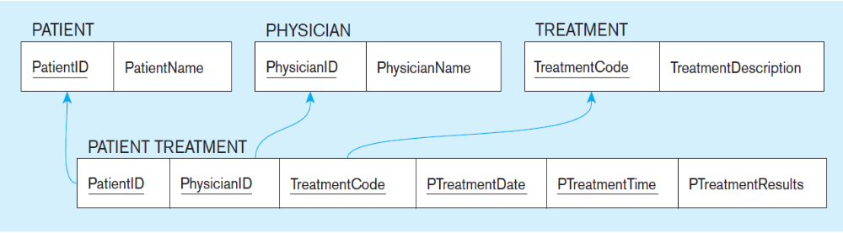
Transforming Ternary Relationship

Slide 29
2. Transforming Relationships
d) Super types / Subtype Relationship
Relations are created against super type and each of its subtypes.
The subtypes will use the PK of the super type

Slide 30
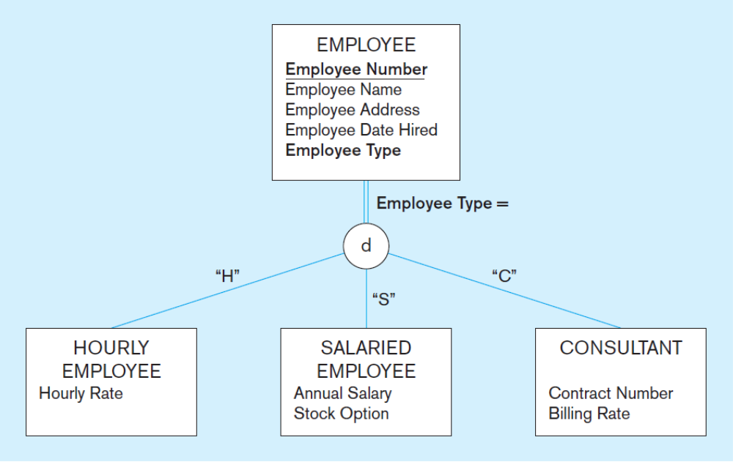

2. Transforming Super types / Subtype Relationship

Slide 31
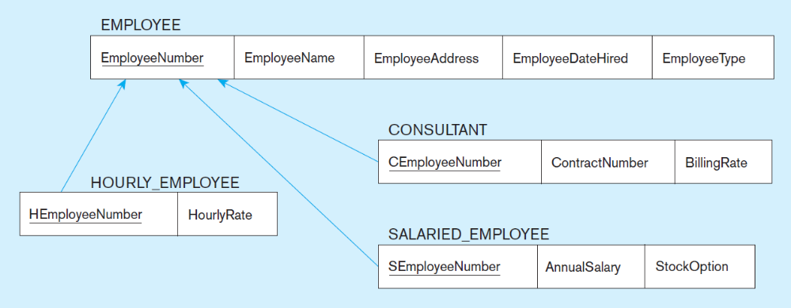
2. Transforming Super types / Subtype Relationship

Slide 32
Reading Material
Book | Chapter | Sections / Pages
Ref. Book A | 4 | Pages 165-178

Slide 33
Thank you for your attention.
Asif Sohail
Assistant Professor
University of the Punjab
Punjab University College of Information Technology (PUCIT)
Allama Iqbal (Old) Campus, Anarkali
Lahore, Pakistan
Tel: +92-(0)42-111-923-923 Ext. 154
E-mail: asif@pucit.edu.pk

